Slide 1
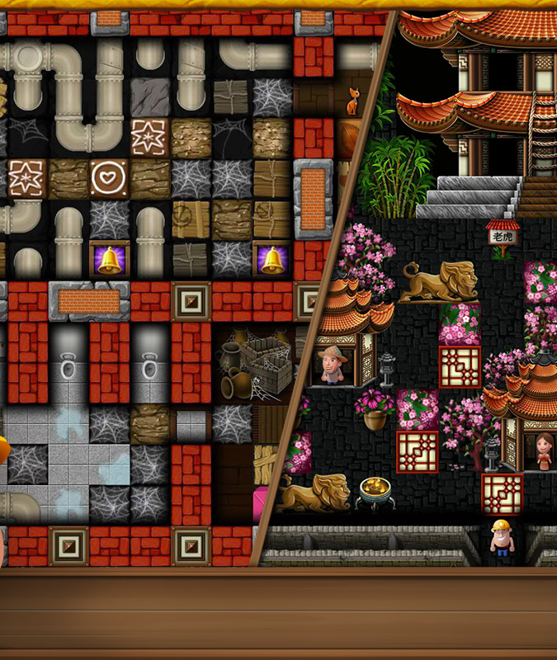

2D Adventure Game
Made By Chirag, IsHAN
D.

Slide 2
Introduction
Single player game
User friendly
Open World
Non Playable Characters also include
Customizable Players
Offline game user can play anywhere everywhere without restrictions of Internet
Indie game

Slide 3
Objective
Our Objective is to make a 2D game which interactable with user
Build a treasure hunting map
Create game mechanics which will help the user to ace the game
Create map for the user to explore
Making the game want the user to play it again.
Create a basic game loop

Slide 4

Roadmap
1) Treasure Hunt 2) Action RPG
Display player Create Sounds
Control player Create Mechanics
Display Objects Create Textures

Slide 5

Existing techniques
Vector art
For game designers, this particular 2D art style is at the top of the most-liked list. The reason is its dynamic user interface and the environment because everything inside the game is created using polygons.

Slide 6

Methodology
Here we are making sure that we are up to date with the modern technologies and will bring the best version of the game. We'll be using Java language to make the Game. We will build the game from scratch into a complete game.
Problem Statement
Improve Graphics
Increase Size of Map
Increase Objects

Slide 7

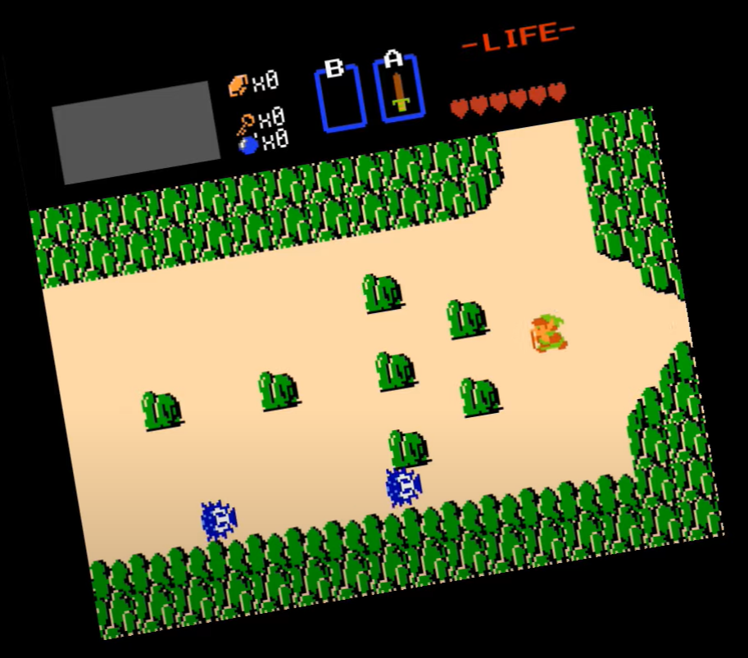
Architecture of proposed system

Slide 8

Explaining Algorithm
Basic Idea is to Create a Game loop Take input from user move character accordingly, update the screen and repaint the screen
Every time a user controlled character move input is given, it does so in response to the instructions of a steering algorithm, a series of mathematical steps which reads the state of the game, calculates the position of each element, and translates that into an instruction to move in a particular direction.
Algorithm to be used for the game is:
Using recursion to search through the game-tree. Algorithm computes the decision for the current state.

Slide 9
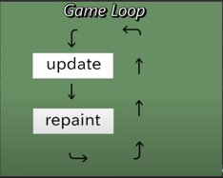
Game Loop Output->Input ->Record Input ->Update ->Repaint

Slide 10

References Used
Game Loop
https://youtu.be/VpH33Uw-_0E
Paint & Repaint in java
https://stackoverflow.com/questions/10768619/paint-and-repaint-in-java
Animation in Java
https://www.javatpoint.com/Animation-in-applet
This Photo by Unknown author is licensed under CC BY-SA-NC.

Slide 11
CONTINUED... References Used
Object placement
https://stackoverflow.com/questions/49120967/object-placement-in-java-applets
Object Interaction
https://stackoverflow.com/questions/23817359/how-objects-interacts-with-each-other-in-java-using-methods
To create sound class in java
https://www.geeksforgeeks.org/play-audio-file-using-java/
This Photo by Unknown author is licensed under CC BY-SA-NC.

Slide 12

THANK YOU

